Slide 1

BANGALORE INSTITUTE OF TECHNOLOGY DEPARTMENT OF ARTIFICIAL INTELLIGENCE AND MACHINE LEARNING
Mini Project Presentation
on
Rainfall Prediction Using Machine Learning
Under the guidance of Submitted By
Subha Meenakshi S Abhishek S
Advance Machine Learning Sukrutha B

Slide 2
INTRODUCTION
Rainfall prediction remains a serious concern and has attracted the attention of governments, industries, risk management entities, as well as the scientific community.
Rainfall is a climatic factor that affects many human activities like agricultural production, construction, power generation, forestry and tourism, among others .

Slide 3
INTRODUCTION
To this extent, rainfall prediction is essential since this variable is the one with the highest correlation with adverse natural events such as landslides, flooding, mass movements and avalanches.
These incidents have affected society for years . Therefore, having an appropriate approach for rainfall prediction makes it possible to take preventive and mitigation measures for these natural phenomena

Slide 4
Methodology
Rainfall prediction is the application of science and technology to predict the conditions of the atmosphere for a given date and year. People have attempted to predict the weather informally for millennia and formally since the 19th century .
Rainfall predictions are made by collecting quantitative data about the current state of the atmosphere at a given place and using meteorology to project how the atmosphere will change.

Slide 5
ABOUT THE DATA
We are predicting rainfall on basis of Temperature, Dew Point, Humidity, Sea Level Pressure, Visibility, Wind of all average values.
Temperature :The average temperature of the air as indicated by a properly exposed thermometer during a given time period, usually a day, a month, or a year.
Wind : wind speed is measured using an anemometer, which is then recorded on the Beaufort scale.
Humidity : A quantity representing the amount of water vapor in the atmosphere

Slide 6
Sea Level Pressure : The atmospheric pressure, at any elevation, reduced by formula to a value approximating the pressure at sea level.
Visibility : The distance one can see as determined by light and weather conditions.
Wind : The perceptible natural movement of the air, especially in the form of a current of air blowing from a particular direction.
Dew Point : The atmospheric temperature (varying according to pressure and humidity) below which water droplets begin to condense and dew can form.

Slide 7
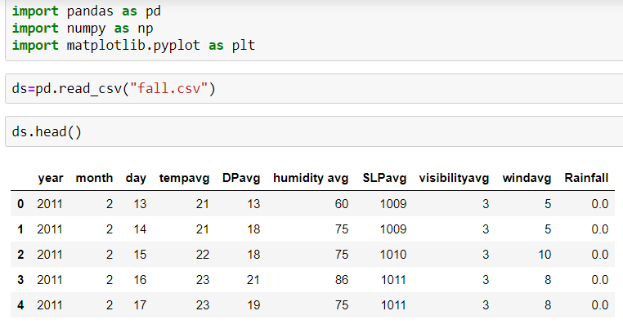
We have taken the values from past 2011 to 2017 including date and month .
We are analyzing the data.
And displaying head of the dataset.

Slide 8
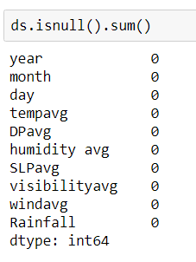
checking any null values are there or not.
We don’t have any null values in our dataset.
If there are any null values, we need to fill it up with the mean value or median value.

Slide 9
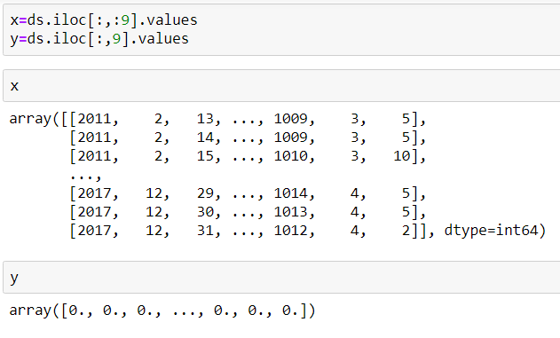
We are taking dependent (y) and independent (x) variables, by using iloc.
And displaying the values of x and y.

Slide 10
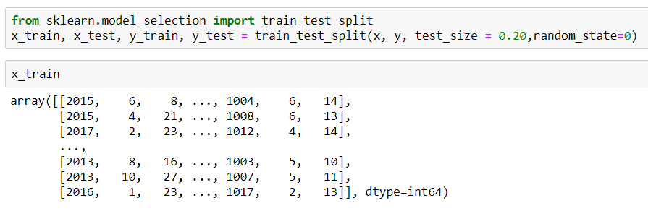
Importing the train_test_split library from sklearn.model_selection.
Training the dataset by using train_test_split Library.
Displaying the x_train values.

Slide 11
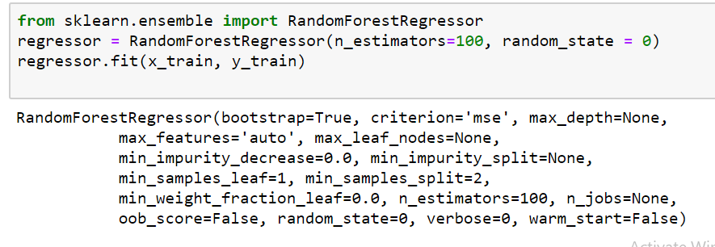
We are using the Random Forest Regressor model to predict the rainfall.
Random Forest is an ensemble technique capable of performing both regression and classification tasks with the use of multiple decision trees and a technique called Bootstrap Aggregation, commonly known as bagging.

Slide 12
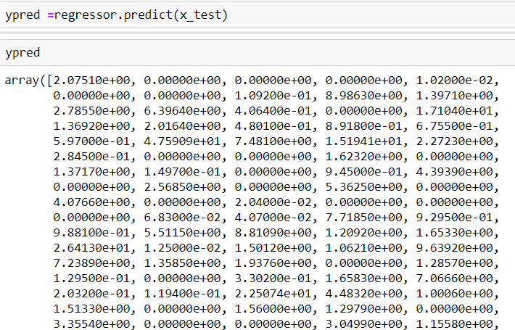
Predicting the values by using trained dataset (x_train). Predicting y_test with the x_test.
Evaluating metrics by importing the metrics library that is the r2_score
We got the accuracy as 0.298

Slide 13
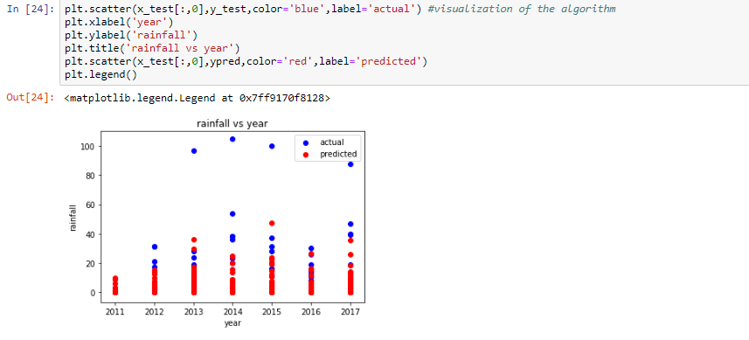
We are using Scatter plotting to plot the relation between the independent and dependent variables.
Here we are showing the relation between the temperature and rainfall.

Slide 14
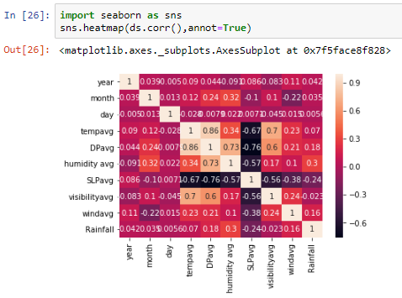
Here we are using the heat map as the visualization technique.
By importing the seaborn library we can plot the Heat Map.

Slide 15
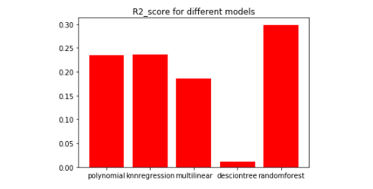
Bar Graph plotted between R2 score of different regression models.
So we choose Random Forest Regression model.

Slide 16
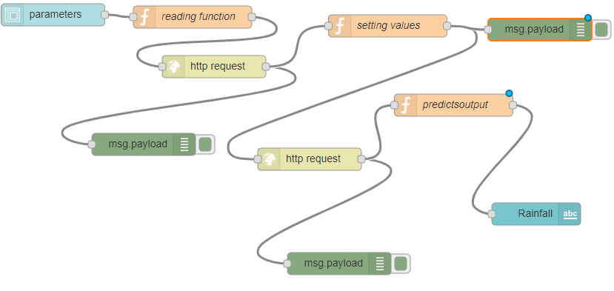
So after the backend development of the project we need to create a API to the code we developed.
Here we use the IBM CLOUD services to create the API
We use IBM WATSON ,MACHINE LEARNING,NODE-RED
to create the front end development of the project.

Slide 17
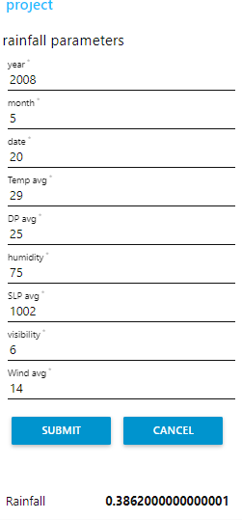
we create the Ibm Watson project and we import the jupyter notebook to that project.
Then atlast we create a node-red flow thus we create a UI.

Slide 18
Findings and suggestions
We found the data from the books we collected and from the weather forecaste centre.
Some of the models we searched from the internet.
There is a lack of competent software professionals and scientists working in Indian meteorological department (IMD) is a big problem in rainfall prediction.
Farmers demand accuracy in long range forecasts that would help them figure out whether or not to sow in the season ,what they need more is forecasts at block level. A block is an administrative unit within a district.

Slide 19
conclusion
This project investigates the use of machine learning methods and particularly suggests in improving the rainfall forecasting.
The rainfall data include the years of 2011-2017.
For a reasonable evaluation of the random forest regression model we conclude that the efficient method among the two input techniques due to simplicity in computation and superior capability of the rainfall forecasting.

Slide 20
Thank You…☺

